Slide 1
Hitting it off with Vim
in two weeks
Baozi Wu

Slide 2
Why Vim
Stan
Already mastered Sublime Text 😎
Cool

Slide 3
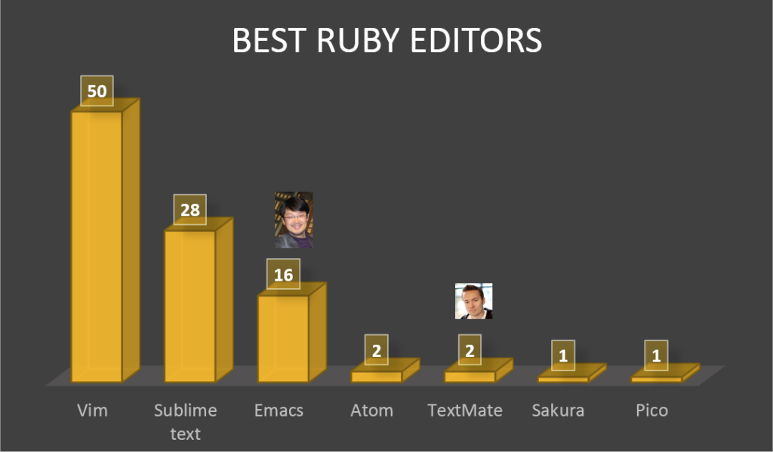
http://www.sitepoint.com/editor-rubyists-use/

Slide 4
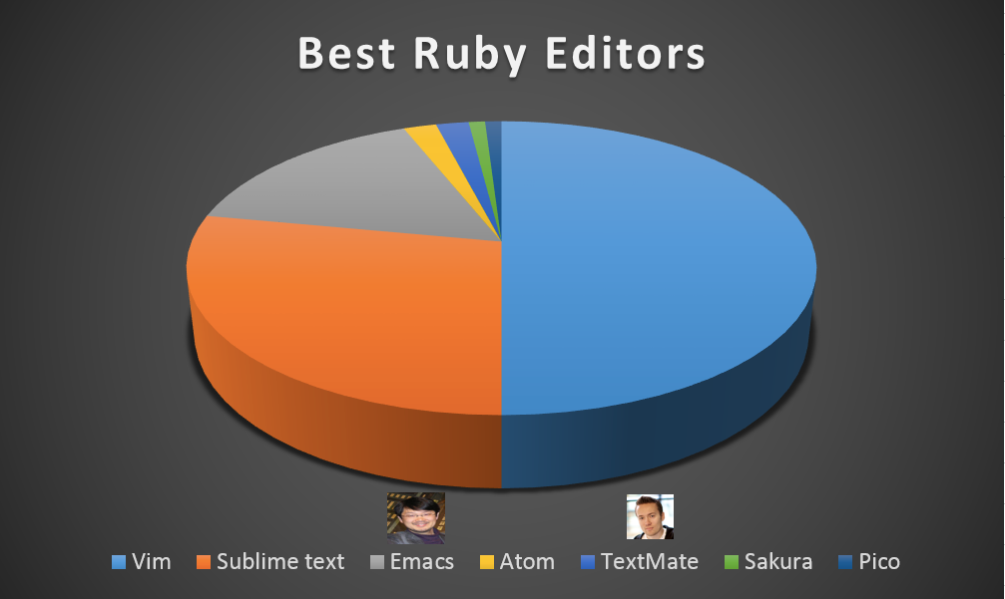
http://www.sitepoint.com/editor-rubyists-use/

Slide 5
MacVim
$ brew install macvim
$ git clone https://github.com/baojjeu/hitting-it-off-with-vim-in-two-weeks
$ mvim [file] -u minimal-vimrc

Slide 6
Three modes
NORMAL
INSERT
VISUAL

Slide 7
Movement
H（←）
J（↓）
K（↑）
L（→）

Slide 8
Google “Vim Adventure”

Slide 9
Move fast
w - Words forward
b - Words backward

Slide 10
Formatting
>> - Positive indentation
<< - Negative indentation
== - Auto indent
gg=G - 😍

Slide 11
Editing
i - Insert text before the cursor
I - Insert text before the first non-blank in the line
a - Append text after the cursor
A - Append text at the end of the line
o - Begin a new line below the cursor and insert text
O - Begin a new line above the cursor and insert text

Slide 12
Selection
v - Start Visual mode per character
V - Start Visual mode linewise

Slide 13
Others
y - Yank text
p - Put the text
. - Repeat last change
u - Undo changes
<C-r> - Redo changes which were undone

Slide 14
Others
/ - Searching
n - Repeat the latest "/"
N - Repeat the latest "/" in opposite direction

Slide 15
Others
:new - Create a new window and start editing an empty file in it
:vnew - Like new, but split vertically
:sp - Split current window in two
:vsp - Like sp, but split vertically
<C-w><C-hjkl> - Switch working window
:q - Close current window
:w - Save changes
zz - Make cursor on the middle of window
zt - Make cursor on the top of window
zb - Make cursor o nthe botton of window

Slide 16
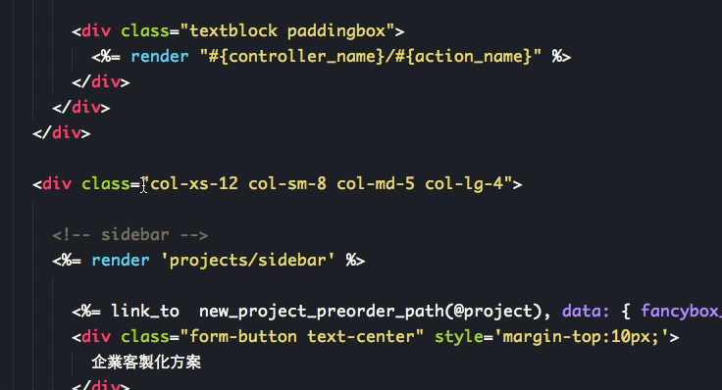

Slide 17


Slide 18
Keystrokes
c i (
Change inner text in parenthesis
c i “
Change inner text in double quotes

Slide 19
Keystrokes
v i (
(VISUAL) Select inner text in parenthesis
v i “
(VISUAL) Select inner text in double quotes

Slide 20
Keystrokes
d i (
Delete inner text in parenthesis
d i “
Delete inner text in double quotes

Slide 21
Keystrokes
[ ]
{ }
‘’

Slide 22
Keystrokes
c i t
Change inner tag
d i t
Delete inner tag

Slide 23
Plugins
$ git clone https://github.com/gmarik/Vundle.vim.git ~/.vim/bundle/Vundle.vim

Slide 24
Plugins
Plugins
" vundle
set rtp+=~/.vim/bundle/Vundle.vim
call vundle#begin()
Plugin 'gmarik/Vundle.vim'
Plugin 'tpope/vim-rails'
call vundle#end()
syntax enable

Slide 25
Plugins
Plugins
:PluginInstall

